Slide 1

Chapter 8
Code Generation

Slide 2
Introduction
The final phase of a compiler is code generator
It receives an intermediate representation (IR) with supplementary information in symbol table
Produces a semantically equivalent target program
Code generator main tasks:
  Instruction selection
  Register allocation and assignment
  Insrtuction ordering
Front end
Code optimizer
Code Generator

Slide 3
Issues in the Design of Code Generator
The most important criterion is that it produces correct code
Input to the code generator
  IR + Symbol table
  We assume front end produces low-level IR, i.e. values of names in it can be directly manipulated by the machine instructions.
  Syntactic and semantic errors have been already detected
The target program
  Common target architectures are: RISC, CISC and Stack based machines

Slide 4
complexity of mapping
the level of the IR
the nature of the instruction-set architecture
the desired quality of the generated code.
a=b+c
d=a+e
x=y+z
LD R0, y
ADD R0, R0, z
ST x, R0
LD R0, b
ADD R0, R0, c
ST a, R0
LD R0, a
ADD R0, R0, e
ST d, R0

Slide 5
Register allocation
Two subproblems
  Register allocation: selecting the set of variables that will reside in registers at each point in the program
  Resister assignment: selecting specific register that a variable reside in
Complications imposed by the hardware architecture
  Example: register pairs for multiplication and division
t=a+b
t=t*c
T=t/d
t=a+b
t=t+c
T=t/d
L R0, a
A R0, b
M R0, c
SRDA R0, 32
D R0, d
ST R1, t
L R1, a
A R1, b
M R0, c
D R0, d
ST R1, t

Slide 6
A simple target machine model
Load operations: LD r,x and LD r1, r2
Store operations: ST x,r
Computation operations: OP dst, src1, src2
Unconditional jumps: BR L
Conditional jumps: Bcond r, L like BLTZ r, L

Slide 7
Addressing Modes
variable name: x
indexed address: a(r) like LD R1, a(R2) means R1=contents(a+contents(R2))
integer indexed by a register : like LD R1, 100(R2)
Indirect addressing mode: *r and *100(r)
immediate constant addressing mode: like LD R1, #100

Slide 8
b = a [i]
LD R1, i //R1 = i
MUL R1, R1, 8 //R1 = Rl * 8
LD R2, a(R1) //R2=contents(a+contents(R1))
ST b, R2 //b = R2

Slide 9
a[j] = c
LD R1, c //R1 = c
LD R2, j // R2 = j
MUL R2, R2, 8 //R2 = R2 * 8
ST a(R2), R1 //contents(a+contents(R2))=R1

Slide 10
x=*p
LD R1, p //R1 = p
LD R2, 0(R1) // R2 = contents(0+contents(R1))
ST x, R2 // x=R2

Slide 11
conditional-jump three-address instruction
If x<y goto L
  LD R1, x // R1 = x
  LD R2, y // R2 = y
  SUB R1, R1, R2 // R1 = R1 - R2
  BLTZ R1, M // i f R1 < 0 jump t o M

Slide 12
costs associated with the addressing modes
LD R0, R1 cost = 1
LD R0, M cost = 2
LD R1, *100(R2) cost = 3

Slide 13
Addresses in the Target Code
A statically determined area Code
A statically determined data area Static
A dynamically managed area Heap
A dynamically managed area Stack

Slide 14
three-address statements for procedure calls and returns
call callee
Return
Halt
action

Slide 15
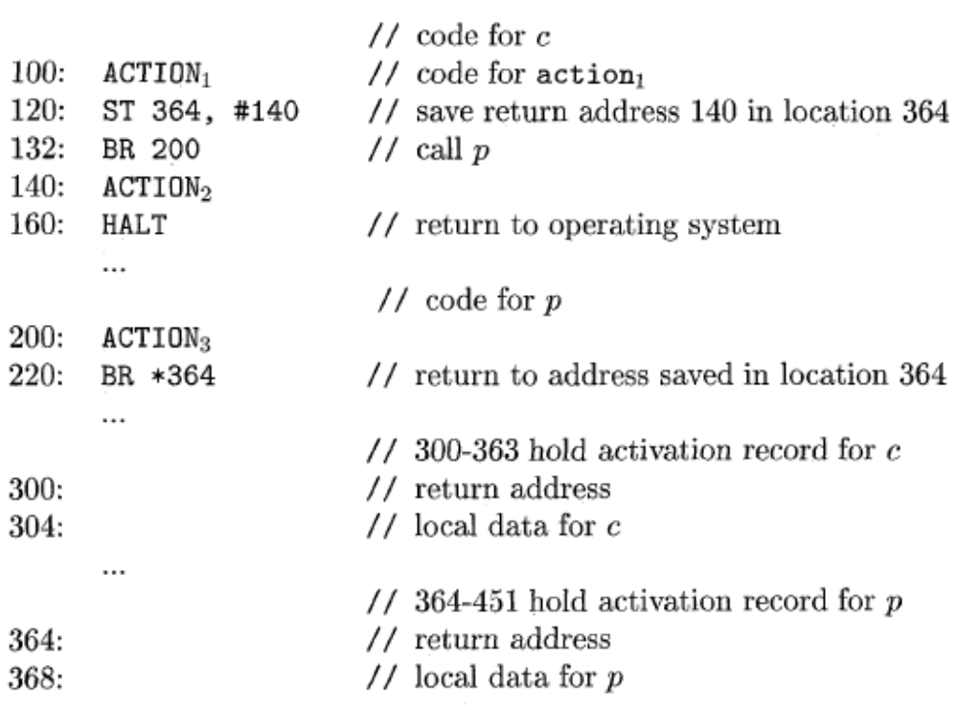
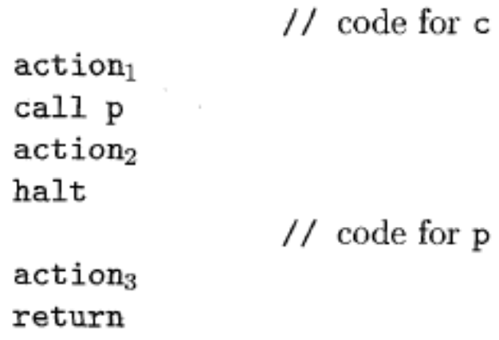
Target program for a sample call and return

Slide 16
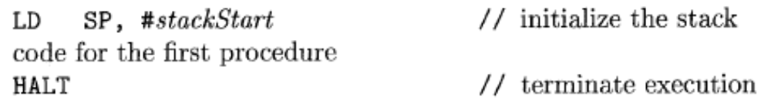
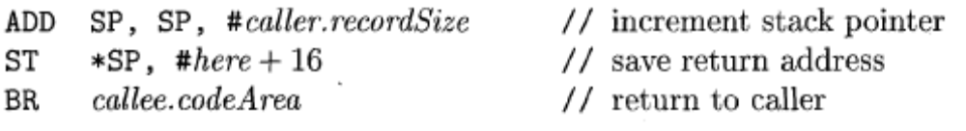
Stack Allocation
Branch to called procedure
Return to caller
in Callee: BR *0(SP)
in caller: SUB SP, SP, #caller.recordsize

Slide 17
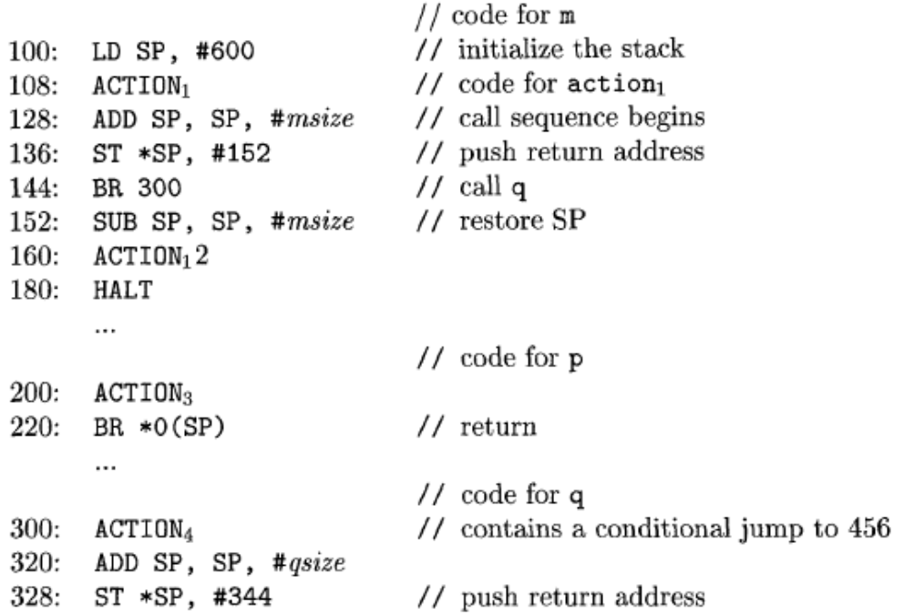
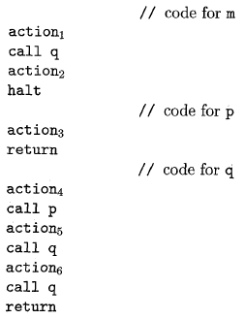
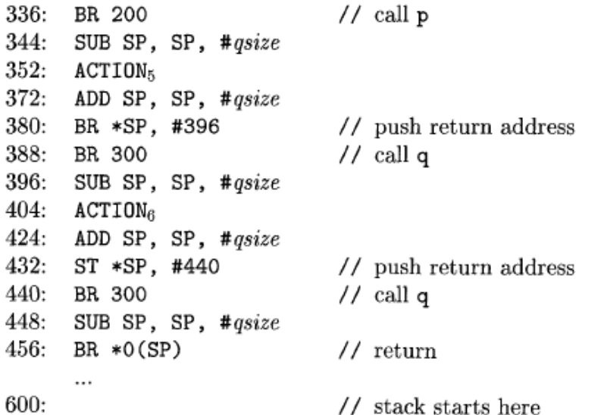
Target code for stack allocation

Slide 18
Basic blocks and flow graphs
Partition the intermediate code into basic blocks
  The flow of control can only enter the basic block through the first instruction in the block. That is, there are no jumps into the middle of the block.
  Control will leave the block without halting or branching, except possibly at the last instruction in the block.
The basic blocks become the nodes of a flow graph

Slide 19
rules for finding leaders
The first three-address instruction in the intermediate code is a leader.
Any instruction that is the target of a conditional or unconditional jump is a leader.
Any instruction that immediately follows a conditional or unconditional jump is a leader.

Slide 20
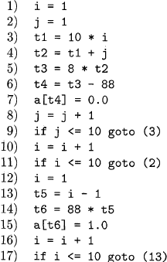
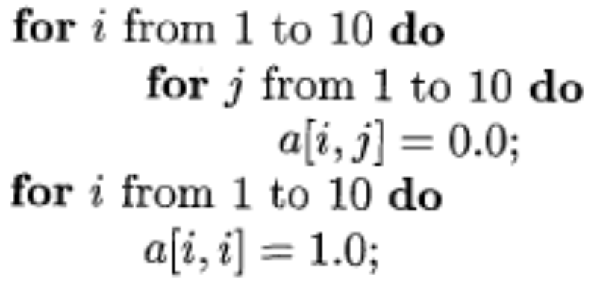
Intermediate code to set a 10*10 matrix to an identity matrix

Slide 21
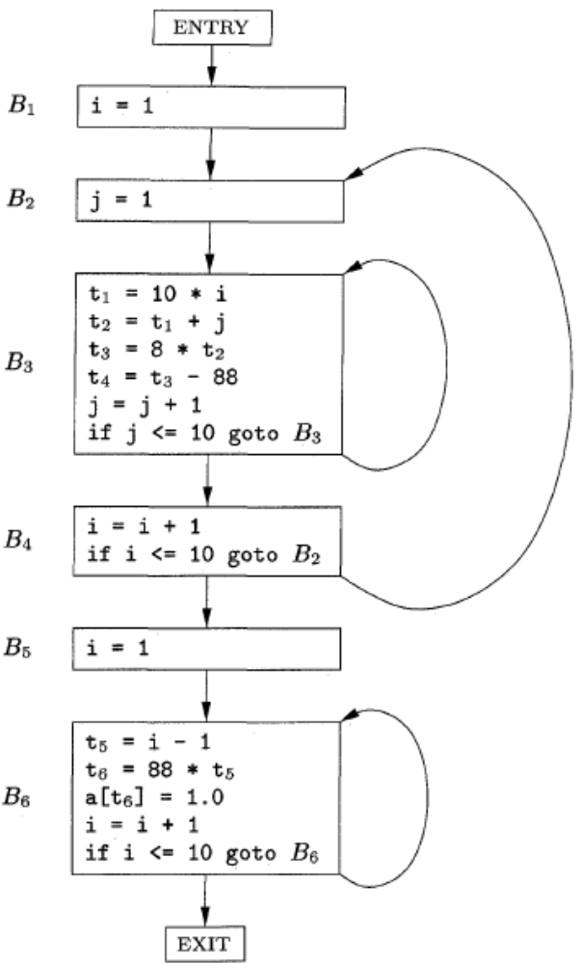
Flow graph based on Basic Blocks

Slide 22
liveness and next-use information
We wish to determine for each three address statement x=y+z what the next uses of x, y and z are.
Algorithm:
  Attach to statement i the information currently found in the symbol table regarding the next use and liveness of x, y, and z.
  In the symbol table, set x to "not live" and "no next use.“
  In the symbol table, set y and z to "live" and the next uses of y and z to i.

Slide 23
DAG representation of basic blocks
There is a node in the DAG for each of the initial values of the variables appearing in the basic block.
There is a node N associated with each statement s within the block. The children of N are those nodes corresponding to statements that are the last definitions, prior to s, of the operands used by s.
Node N is labeled by the operator applied at s, and also attached to N is the list of variables for which it is the last definition within the block.
Certain nodes are designated output nodes. These are the nodes whose variables are live on exit from the block.

Slide 24
Code improving transformations
We can eliminate local common subexpressions, that is, instructions that compute a value that has already been computed.
We can eliminate dead code, that is, instructions that compute a value that is never used.
We can reorder statements that do not depend on one another; such reordering may reduce the time a temporary value needs to be preserved in a register.
We can apply algebraic laws to reorder operands of three-address instructions, and sometimes t hereby simplify t he computation.

Slide 25

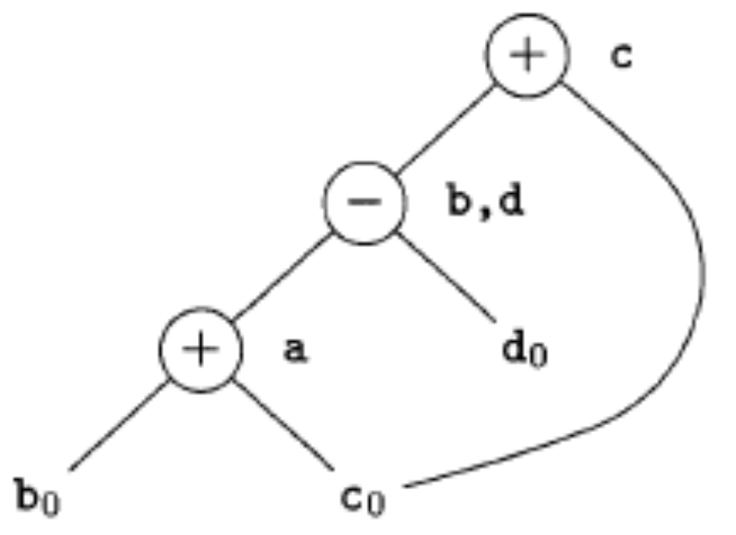
DAG for basic block

Slide 26
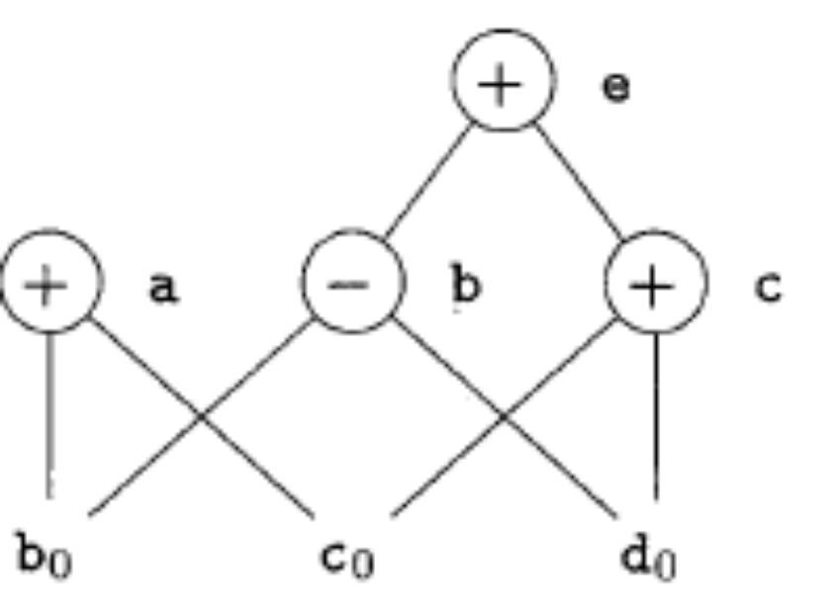

DAG for basic block

Slide 27
array accesses in a DAG
An assignment from an array, like x = a [i], is represented by creating a node with operator =[] and two children representing the initial value of the array, a0 in this case, and the index i. Variable x becomes a label of this new node.
An assignment to an array, like a [j] = y, is represented by a new node with operator []= and three children representing a0, j and y. There is no variable labeling this node. What is different is that the creation of this node kills all currently constructed nodes whose value depends on a0. A node that has been killed cannot receive any more labels; that is, it cannot become a common subexpression.

Slide 28
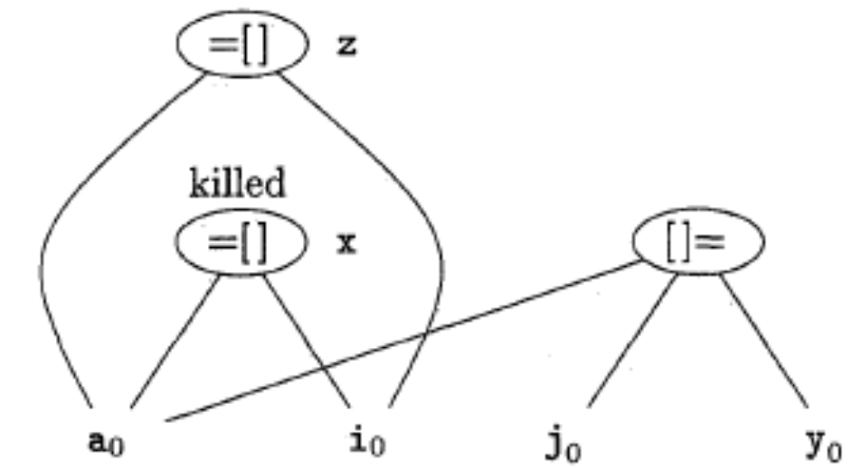
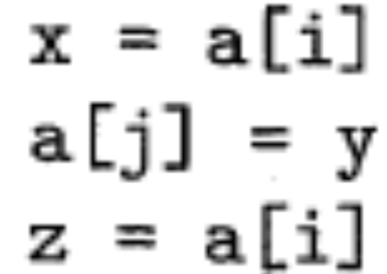
DAG for a sequence of array assignments

Slide 29
Rules for reconstructing the basic block from a DAG
The order of instructions must respect the order of nodes in the DAG. That is, we cannot compute a node's value until we have computed a value for each of its children.
Assignments to an array must follow all previous assignments to, or evaluations from, the same array, according to the order of these instructions in the original basic block.
Evaluations of array elements must follow any previous (according to the original block) assignments to the same array. The only permutation allowed is that two evaluations from the same array may be done in either order, as long as neither crosses over an assignment to that array.
Any use of a variable must follow all previous (according to the original block) procedure calls or indirect assignments through a pointer.
Any procedure call or indirect assignment through a pointer must follow all previous (according to the original block) evaluations of any variable.

Slide 30
principal uses of registers
In most machine architectures, some or all of the operands of an operation must be in registers in order to perform the operation.
Registers make good temporaries - places to hold the result of a subexpression while a larger expression is being evaluated, or more generally, a place to hold a variable that is used only within a single basic block.
Registers are often used to help with run-time storage management, for example, to manage the run-time stack, including the maintenance of stack pointers and possibly the top elements of the stack itself.

Slide 31
Descriptors for data structure
For each available register, a register descriptor keeps track of the variable names whose current value is in that register. Since we shall use only those registers that are available for local use within a basic block, we assume that initially, all register descriptors are empty. As the code generation progresses, each register will hold the value of zero or more names.
For each program variable, an address descriptor keeps track of the location or locations where the current value of that variable can be found. The location might be a register, a memory address, a stack location, or some set of more than one of these. The information can be stored in the symbol-table entry for that variable name.

Slide 32
Machine Instructions for Operations
Use getReg(x = y + z) to select registers for x, y, and z. Call these R_{x}, R_{y} and R_{z}.
If y is not in R_{y} (according to the register descriptor for R_{y}), then issue an instruction LD R_{y}, y', where y' is one of the memory locations for y (according to the address descriptor for y).
Similarly, if z is not in R_{z}, issue and instruction LD R_{z}, z', where z' is a location for x .
Issue the instruction ADD R_{x} , R_{y}, R_{z}.

Slide 33
Rules for updating the register and address descriptors
For the instruction LD R, x
  Change the register descriptor for register R so it holds only x.
  Change the address descriptor for x by adding register R as an additional location.
For the instruction ST x, R, change the address descriptor for x to include its own memory location.
For an operation such as ADD R_{x}, R_{y}, R_{z} implementing a three-address instruction x = y + x
  Change the register descriptor for R_{x} so that it holds only x.
  Change the address descriptor for x so that its only location is R_{x}. Note that the memory location for x is not now in the address descriptor for x.
  Remove R_{x} from the address descriptor of any variable other than x.
When we process a copy statement x = y, after generating the load for y into register R_{y}, if needed, and after managing descriptors as for all load statements (per rule I):
  Add x to the register descriptor for R_{y.}
  Change the address descriptor for x so that its only location is R_{y} .

Slide 34
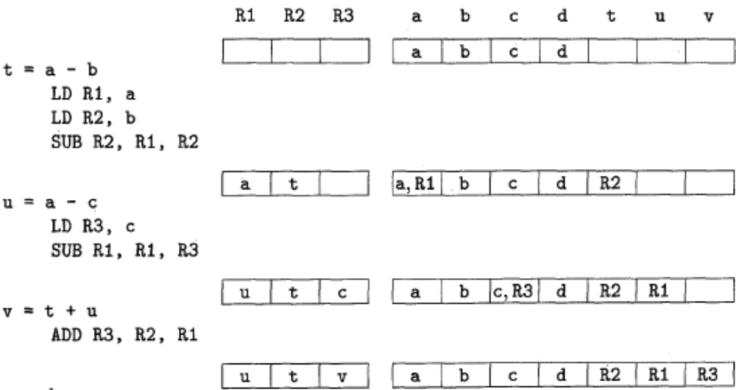
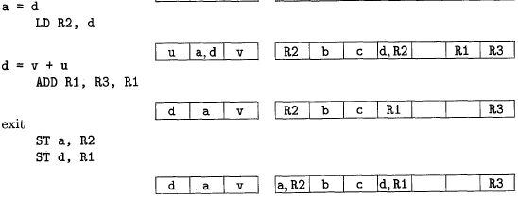
Instructions generated and the changes in the register and address descriptors

Slide 35
Rules for picking register R_{y} for y
If y is currently in a register, pick a register already containing y as R_{y}. Do not issue a machine instruction to load this register, as none is needed.
If y is not in a register, but there is a register that is currently empty, pick one such register as R_{y}.
The difficult case occurs when y is not in a register, and there is no register that is currently empty. We need to pick one of the allowable registers anyway, and we need to make it safe to reuse.

Slide 36
Possibilities for value of R
If the address descriptor for v says that v is somewhere besides R, then we are OK.
If v is x, the value being computed by instruction I, and x is not also one of the other operands of instruction I (z in this example), then we are OK. The reason is that in this case, we know this value of x is never again going to be used, so we are free to ignore it.
Otherwise, if v is not used later (that is, after the instruction I, there are no further uses of v, and if v is live on exit from the block, then v is recomputed within the block), then we are OK.
If we are not OK by one of the first two cases, then we need to generate the store instruction ST v, R to place a copy of v in its own memory location. This operation is called a spill.

Slide 37
Selection of the register Rx
Since a new value of x is being computed, a register that holds only x is always an acceptable choice for Rx.
If y is not used after instruction I, and Ry holds only y after being loaded, Ry can also be used as Rx. A similar option holds regarding z and Rx.

Slide 38
Possibilities for value of R
If the address descriptor for v says that v is somewhere besides R, then we are OK.
If v is x, the value being computed by instruction I, and x is not also one of the other operands of instruction I (z in this example), then we are OK. The reason is that in this case, we know this value of x is never again going to be used, so we are free to ignore it.
Otherwise, if v is not used later (that is, after the instruction I, there are no further uses of v, and if v is live on exit from the block, then v is recomputed within the block), then we are OK.
If we are not OK by one of the first two cases, then we need to generate the store instruction ST v, R to place a copy of v in its own memory location. This operation is called a spill.

Slide 39
Characteristic of peephole optimizations
Redundant-instruction elimination
Flow-of-control optimizations
Algebraic simplifications
Use of machine idioms

Slide 40
Redundant-instruction elimination
LD a, R0
ST R0, a
if debug == 1 goto L1
goto L2
L I : print debugging information
L2:

Slide 41
Flow-of-control optimizations
goto L1
...
Ll: goto L2
Can be replaced by:
goto L2
...
Ll: goto L2
if a<b goto L1
...
Ll: goto L2
Can be replaced by:
if a<b goto L2
...
Ll: goto L2

Slide 42
Algebraic simplifications
x=x+0
x=x*1

Slide 43
Register Allocation and Assignment
Global Register Allocation
Usage Counts
Register Assignment for Outer Loops
Register Allocation by Graph Coloring

Slide 44
Global register allocation
Previously explained algorithm does local (block based) register allocation
This resulted that all live variables be stored at the end of block
To save some of these stores and their corresponding loads, we might arrange to assign registers to frequently used variables and keep these registers consistent across block boundaries (globally)
Some options are:
  Keep values of variables used in loops inside registers
  Use graph coloring approach for more globally allocation

Slide 45
Usage counts
For the loops we can approximate the saving by register allocation as:
  Sum over all blocks (B) in a loop (L)
  For each uses of x before any definition in the block we add one unit of saving
  If x is live on exit from B and is assigned a value in B, then we ass 2 units of saving

Slide 46
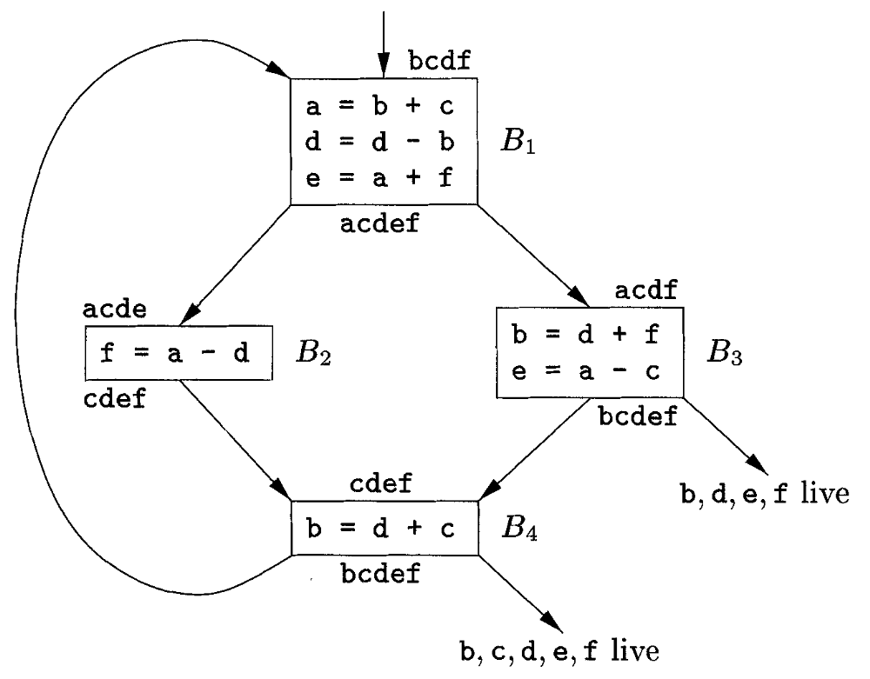
Flow graph of an inner loop

Slide 47
Code sequence using global register assignment

Slide 48
Register allocation by Graph coloring
Two passes are used
  Target-machine instructions are selected as though there are an infinite number of symbolic registers
  Assign physical registers to symbolic ones
    Create a register-interference graph
    Nodes are symbolic registers and edges connects two nodes if one is live at a point where the other is defined.
    For example in the previous example an edge connects a and d in the graph
    Use a graph coloring algorithm to assign registers.

Slide 49
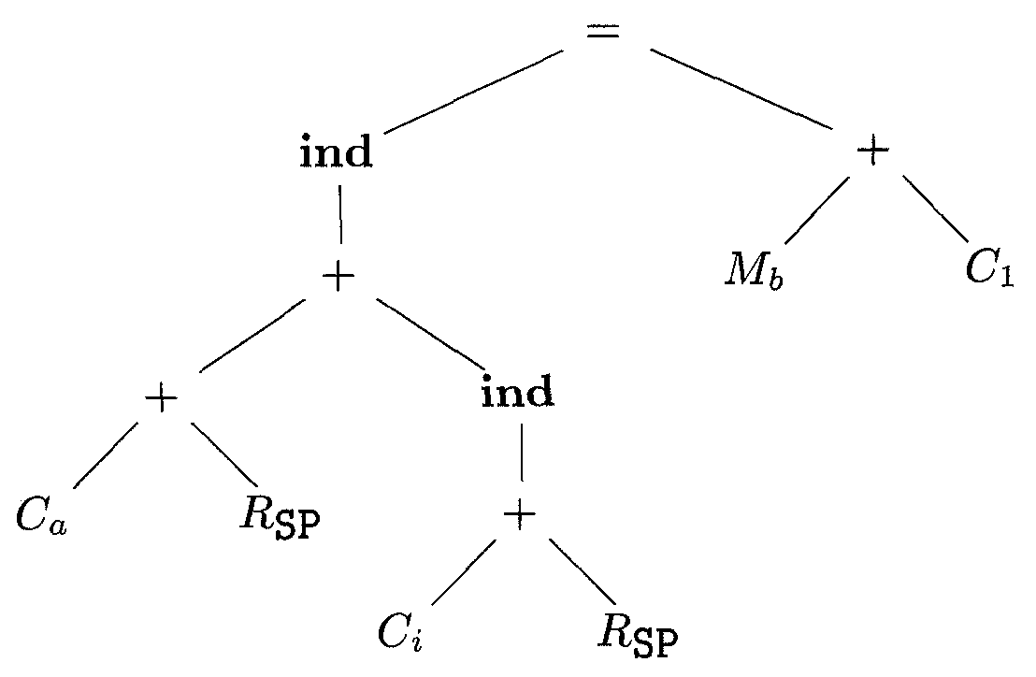
Intermediate-code tree for a[i]=b+1

Slide 50
Tree-rewriting rules

Slide 51
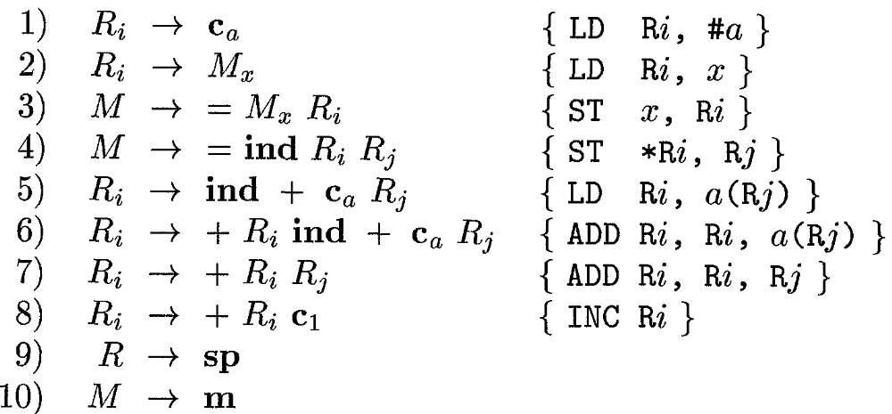
Syntax-directed translation scheme

Slide 52
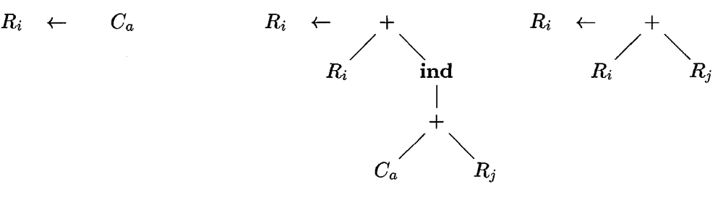
An instruction set for tree matching

Slide 53
Ershov Numbers
Label any leaf 1.
The label of an interior node with one child is the label of its child.
The label of an interior node with two children is
  The larger of the labels of its children, if those labels are different.
  One plus the label of its children if the labels are the same.

Slide 54
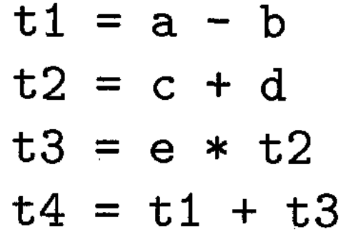
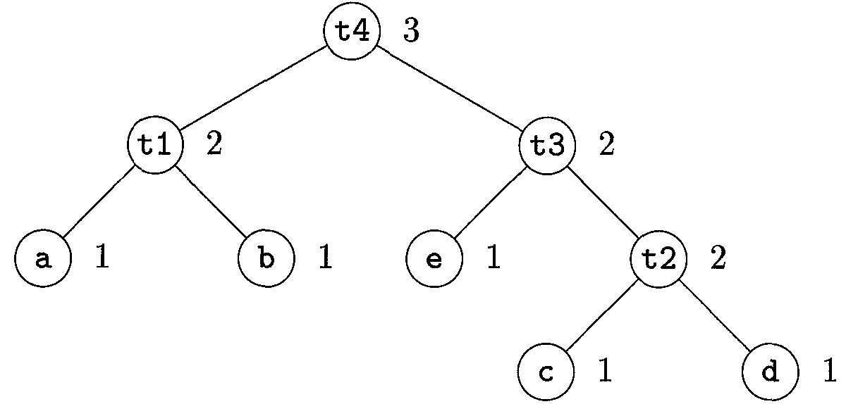
A tree labeled with Ershov numbers

Slide 55
Generating code from a labeled expression tree
To generate machine code for an interior node with label k and two children with equal labels (which must be k - l) do the following:
  Recursively generate code for the right child, using base b+1. The result of the right child appears in register R_{b+k}.
  Recursively generate code for the left child, using base b; the result appears in R_{b+k-1}.
  Generate the instruction OP R_{b+k}, R_{b+k-1}, R_{b+k}, where OP is the appropriate operation for the interior node in question.
Suppose we have an interior node with label k and children with unequal labels. Then one of the children, which we'll call the "big" child, has label k , and the other child, the "little" child, has some label m < k. Do the following to generate code for this interior node, using base b:
  Recursively generate code for the big child, using base b; the result appears in register R_{b+k-l}.
  Recursively generate code for the small child, using base b; the result appears in register R_{b+m-l}. Note that since m < k, neither R_{b+k-l} nor any higher-numbered register is used.
  Generate the instruction OP R_{b+k-l}, R_{b+m-l}, R_{b+k-1} or the instruction OP R_{b+k-l}, R_{b+k-l}, R_{b+m+l}, depending on whether the big child is the right or left child, respectively.
For a leaf representing operand x, if the base is b generate the instruction LD R_{b}, x.

Slide 56
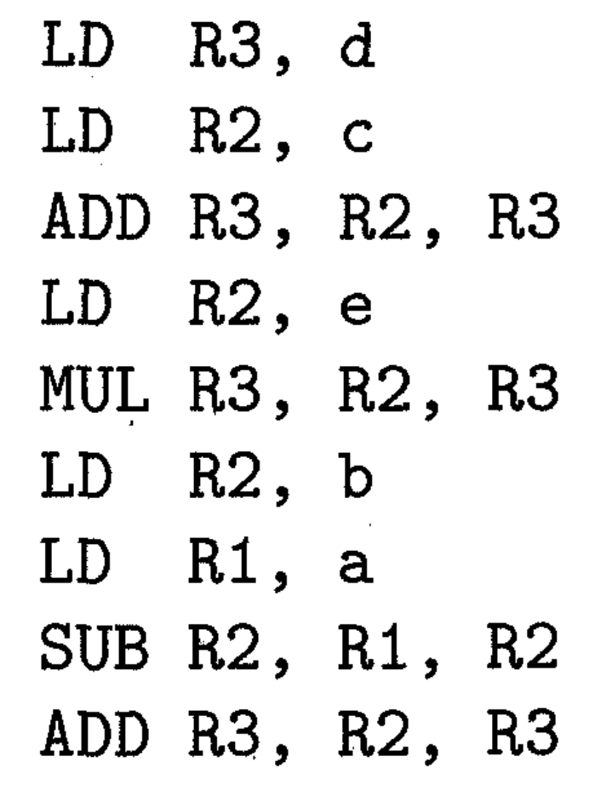
Optimal three-register code

Slide 57
Evaluating Expressions with an Insufficient Supply of Registers
Node N has at least one child with label r or greater. Pick the larger child (or either if their labels are the same) to be the "big" child and let the other child be the "little" child.
Recursively generate code for the big child, using base b = 1. The result of this evaluation will appear in register R_{r}
Generate the machine instruction ST t_{k}, R_{r}, where t_{k} is a temporary variable used for temporary results used to help evaluate nodes with label k.
Generate code for the little child as follows. If the little child has label r or greater, pick base b=1. If the label of the little child is j<r, then pick b=r-j. Then recursively apply this algorithm to the little child; the result appears in R_{r}.
Generate the instruction LD R_{r}-l, t_{k}.
If the big child is the right child of N, then generate the instruction OP R_{r}, R_{r}, R_{r-1}. If the big child is the left child, generate OP R_{r}, R_{r-1}, R_{r}.

Slide 58
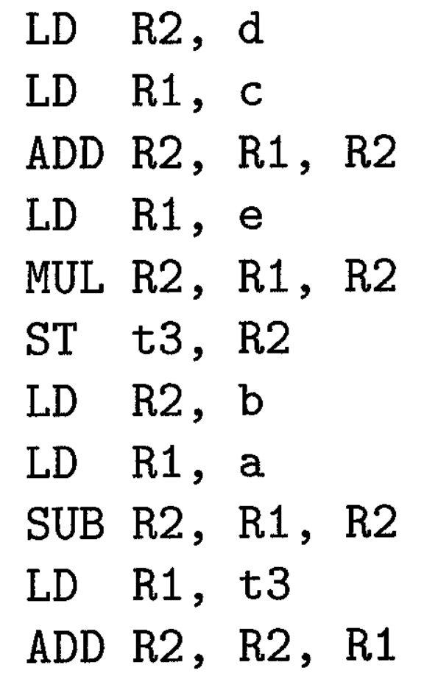
Optimal three-register code using only two registers

Slide 59

Dynamic Programming Algorithm
Compute bottom-up for each node n of the expression tree T an array C of costs, in which the ith component C[i] is the optimal cost of computing the subtree S rooted at n into a register, assuming i registers are available for the computation, for
Traverse T, using the cost vectors to determine which subtrees of T must be computed into memory.
Traverse each tree using the cost vectors and associated instructions to generate the final target code. The code for the subtrees computed into memory locations is generated first.

Slide 60
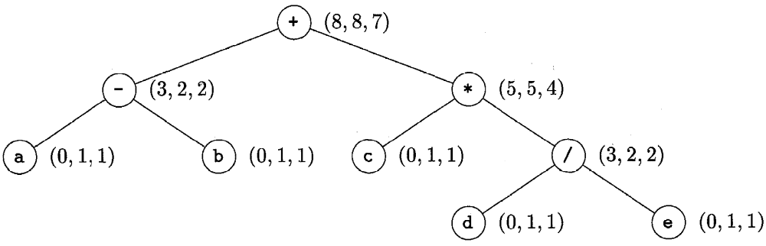
Syntax tree for (a-b)+c*(d/e) with cost vector at each node

Slide 61
minimum cost of evaluating the root with two registers available
Compute the left subtree with two registers available into register R0, compute the right subtree with one register available into register R1, and use the instruction ADD R0, R0, R1 to compute the root. This sequence has cost 2+5+1=8.
Compute the right subtree with two registers available into R l , compute the left subtree with one register available into R0, and use the instruction ADD R0, R0, R1. This sequence has cost 4+2+1=7.
Compute the right subtree into memory location M, compute the left subtree with two registers available into register RO, and use the instruction ADD R0, R0, M. This sequence has cost 5+2+1=8.

